Slide 1
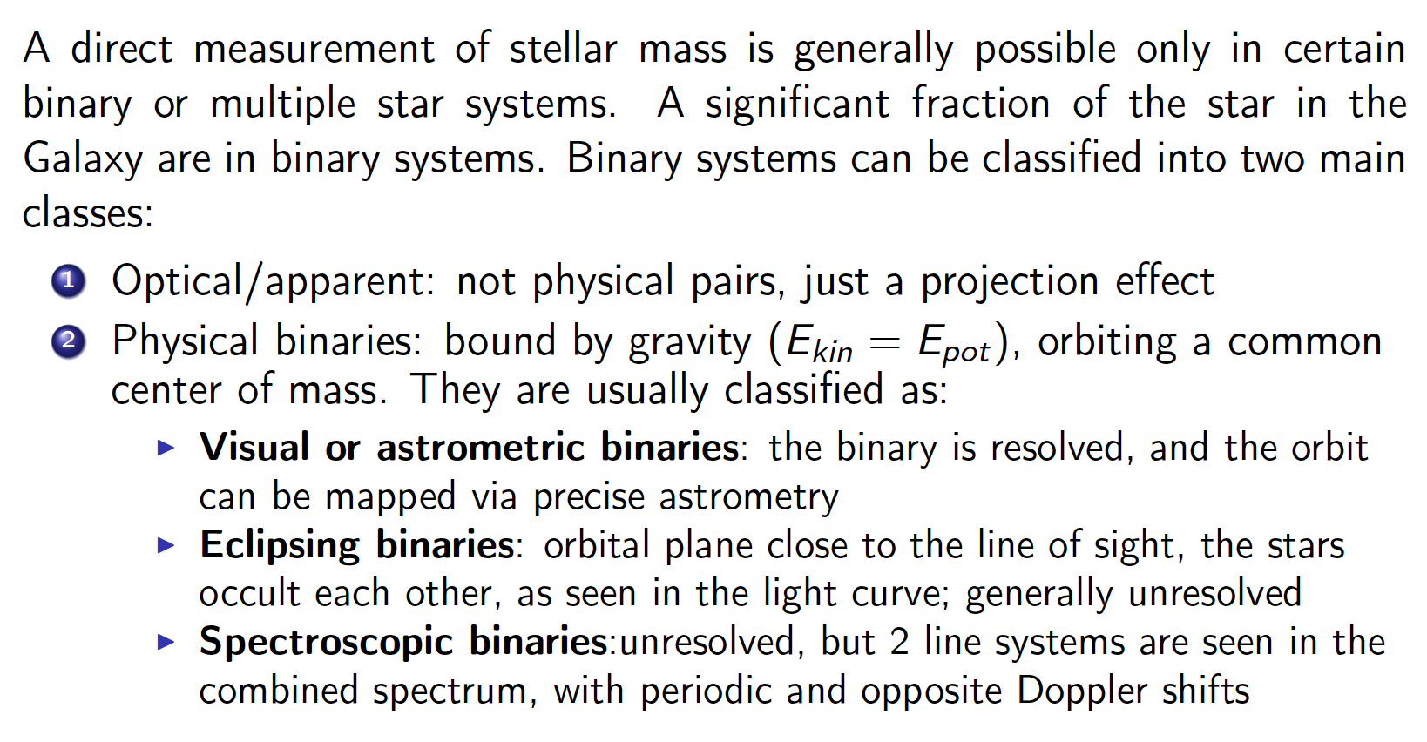
Stellar Mass

Slide 2
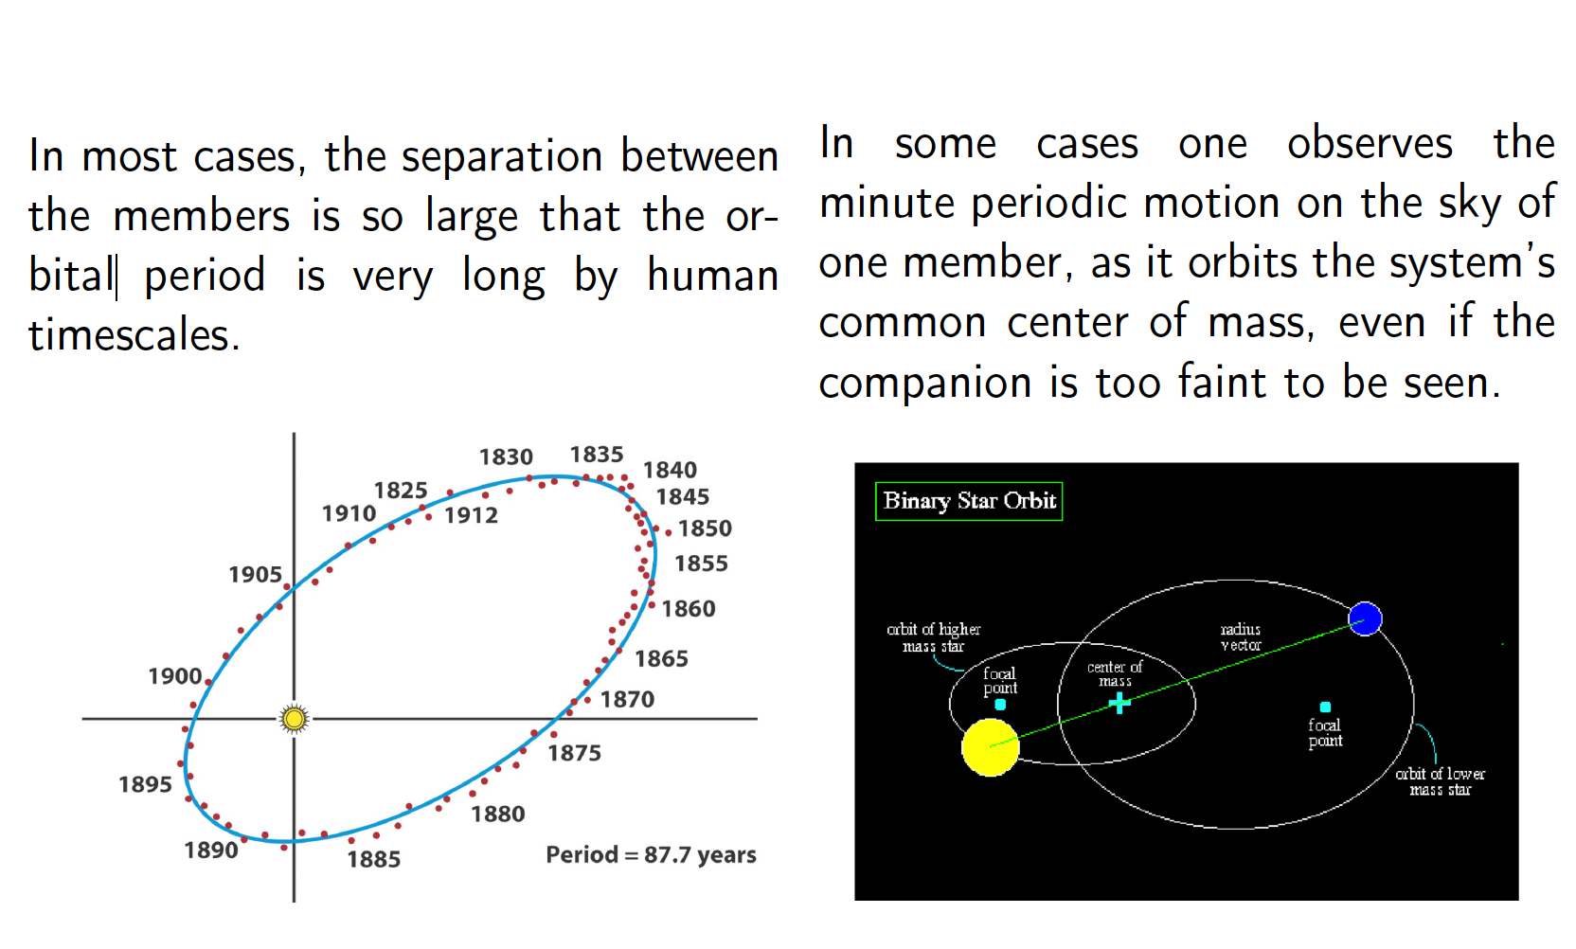
Visual Binaries

Slide 3
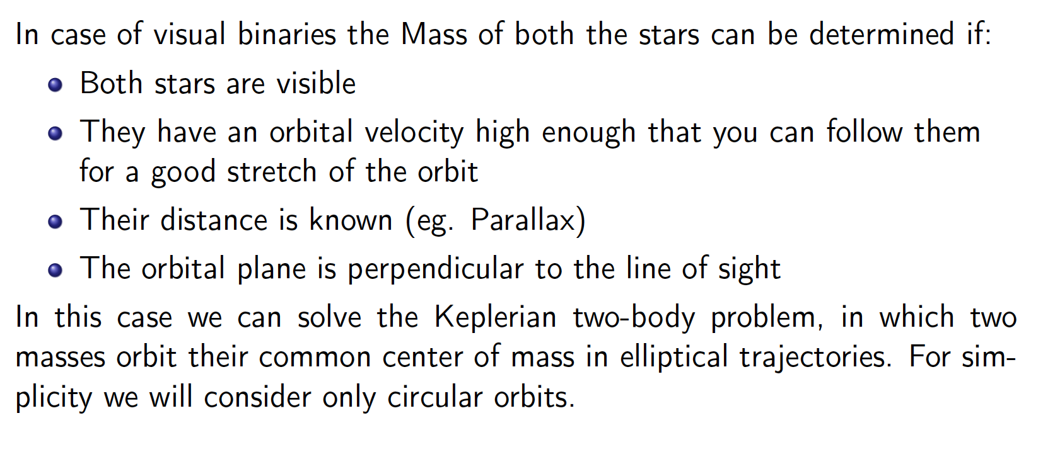
Visual Binaries

Slide 4
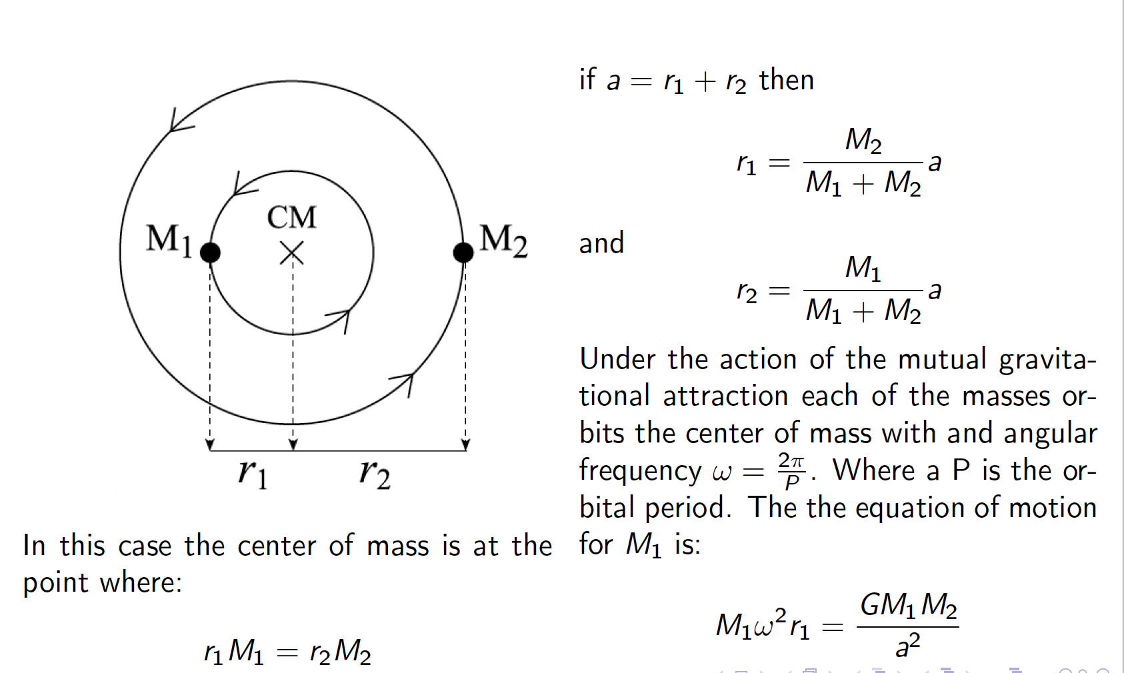

Visual Binaries

Slide 5
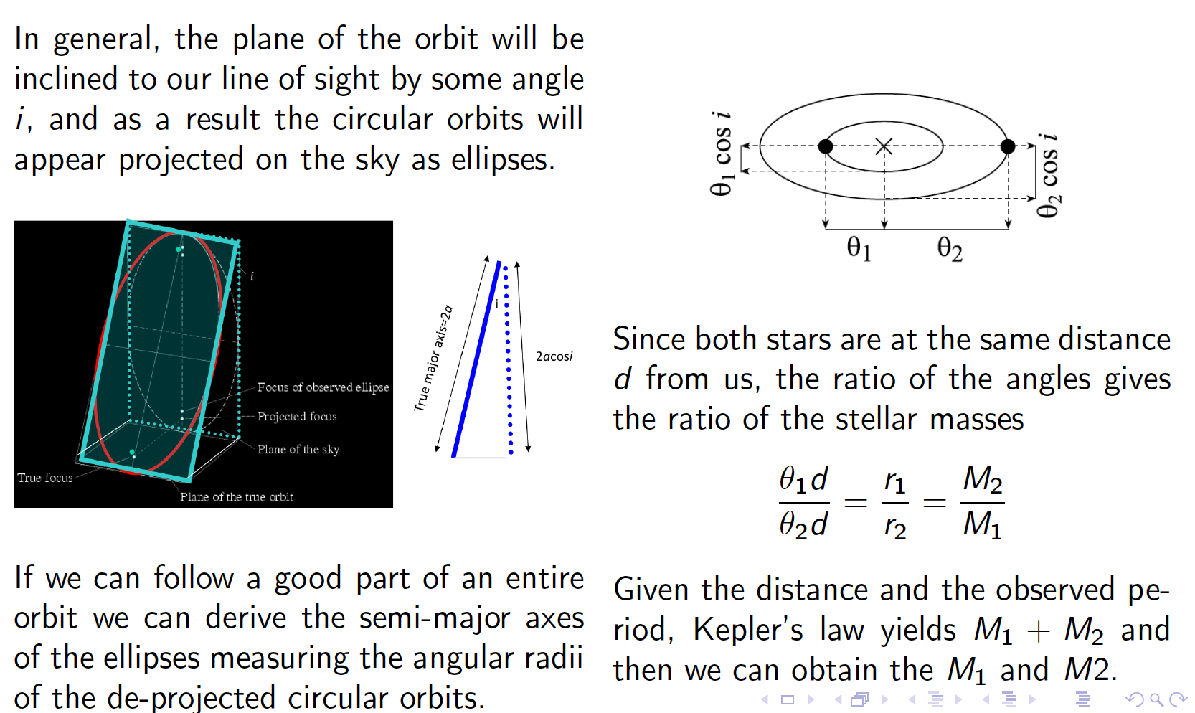
Visual Binaries

Slide 6
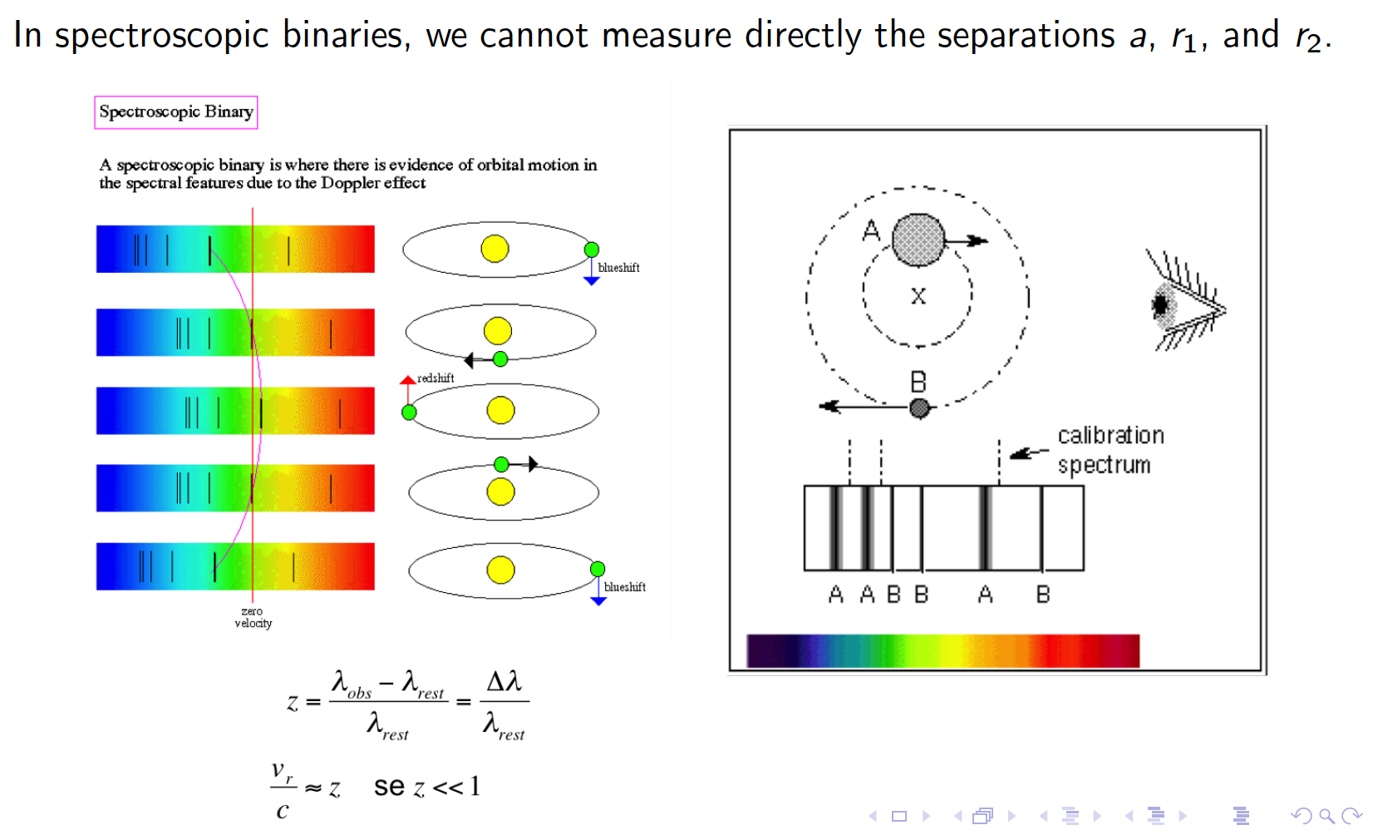
Spectroscopic Binaries

Slide 7
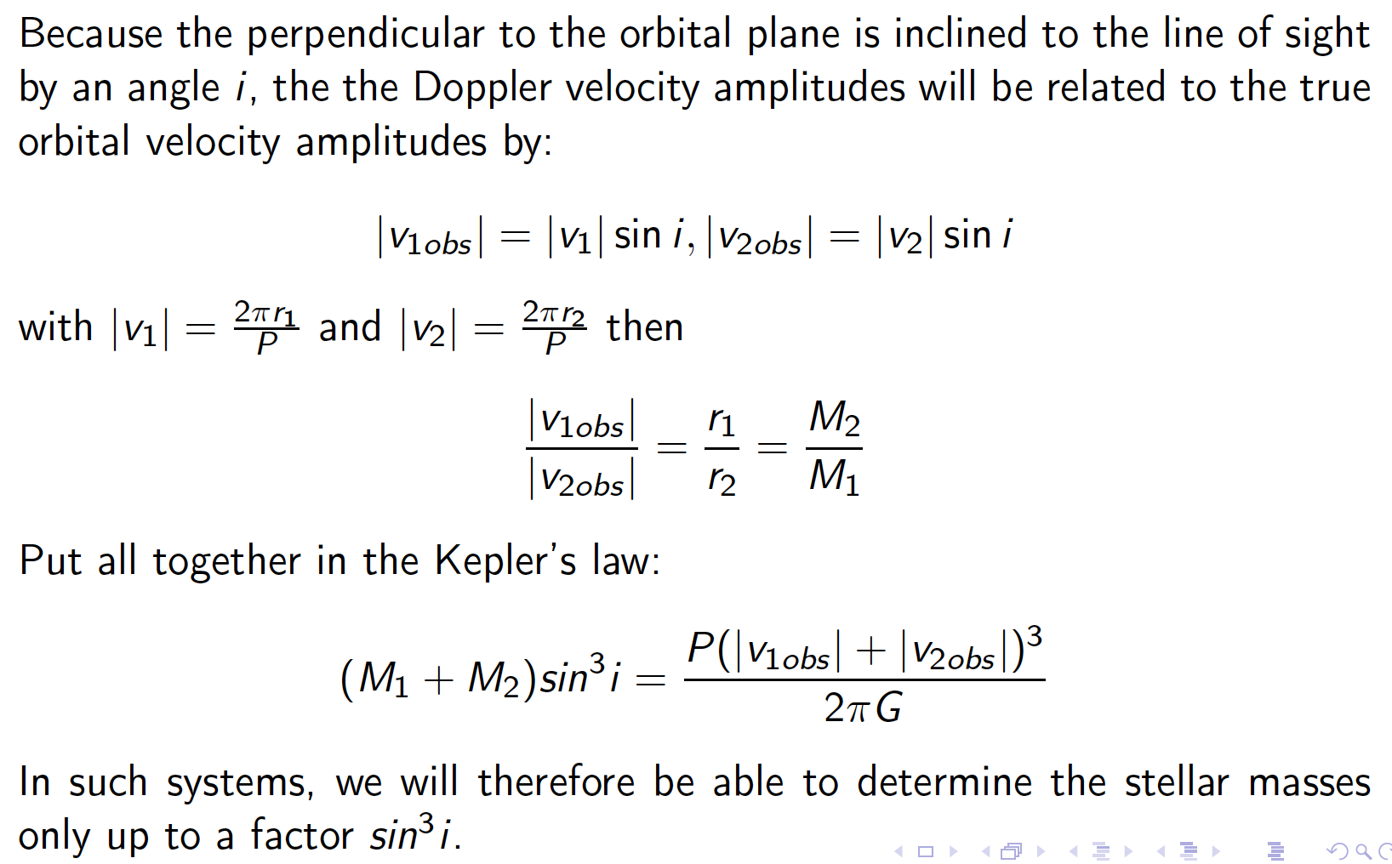
Spectroscopic Binaries

Slide 8
Spectroscopic Binaries

Slide 9
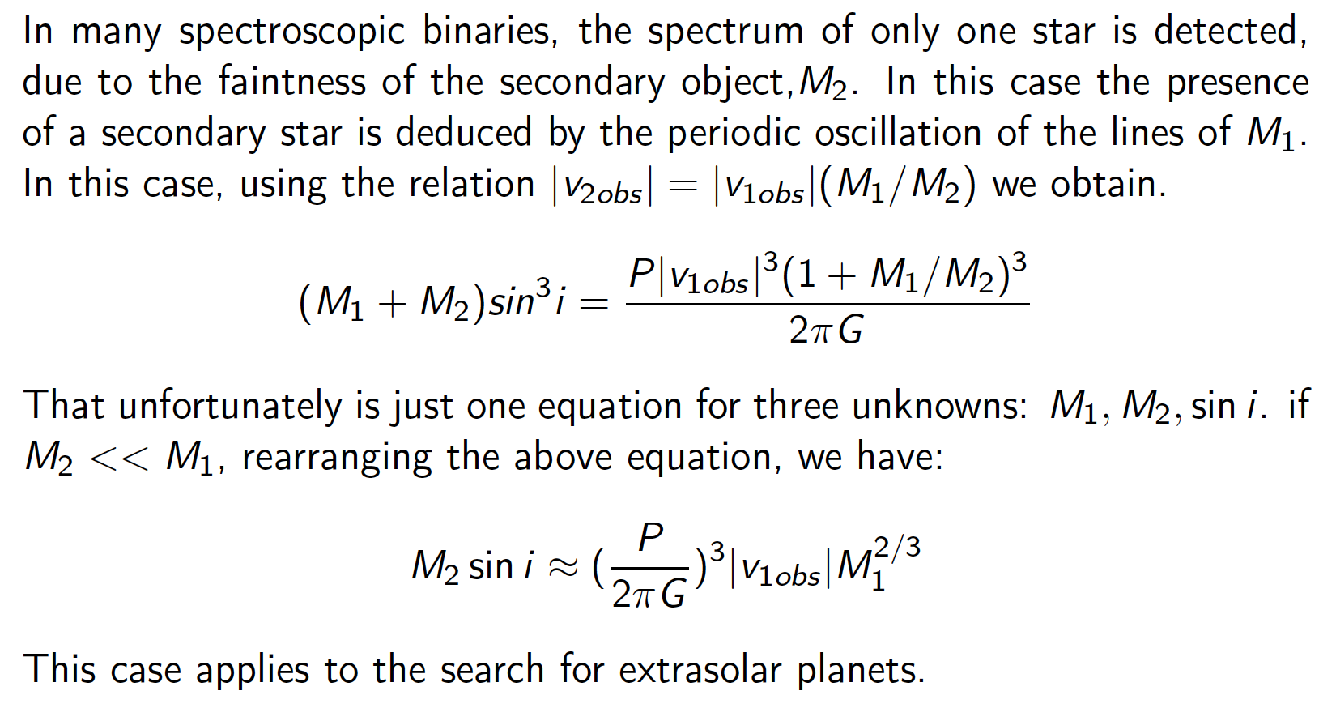
Spectroscopic Binaries

Slide 10
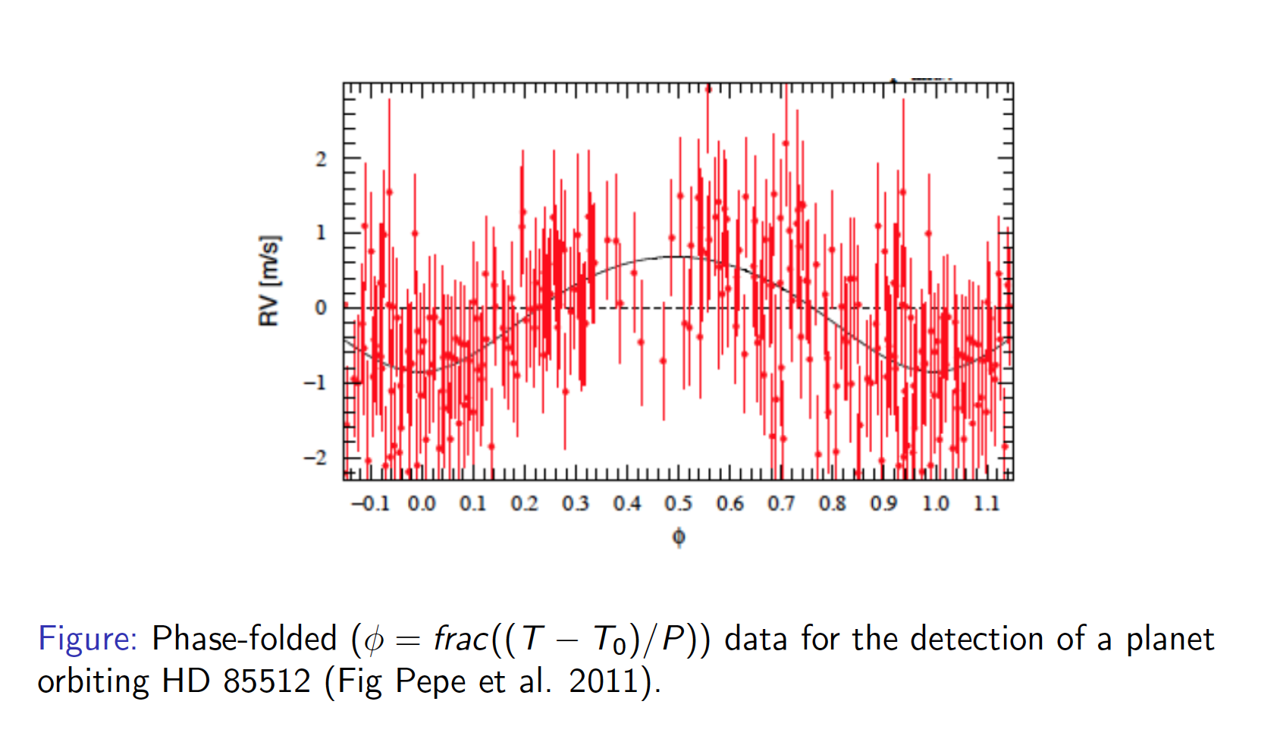
Spectroscopic Binaries

Slide 11
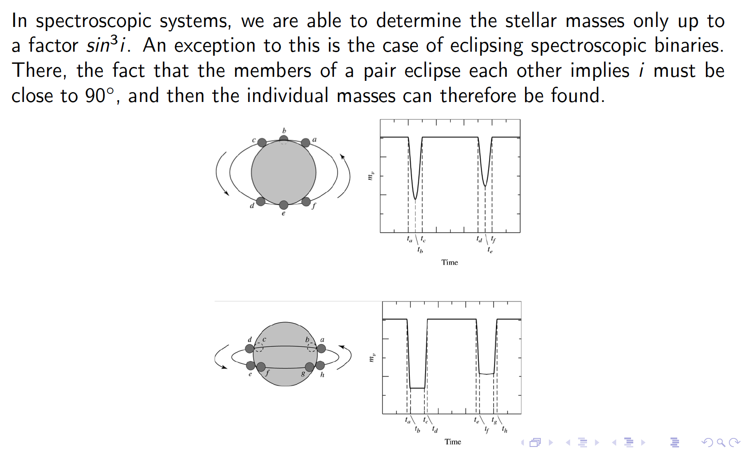
Eclipsing Binaries

Slide 12
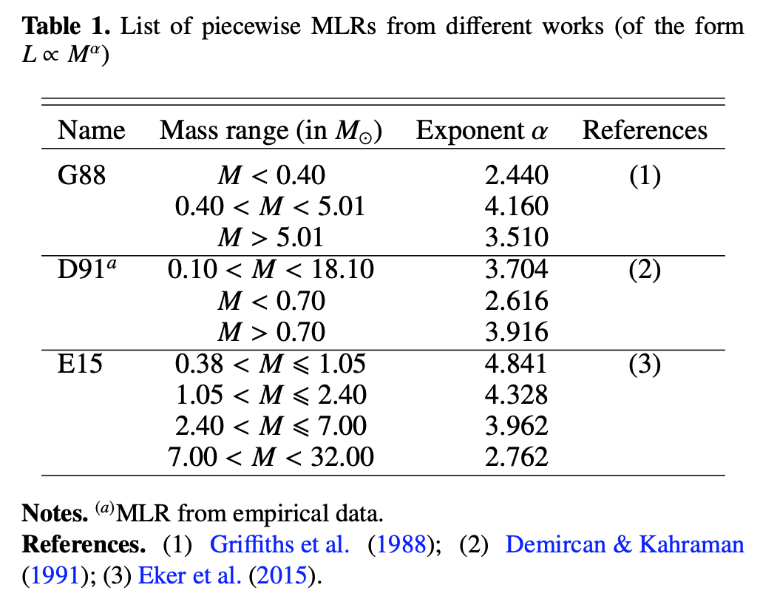

Mass-Luminosity Diagram
$$L∝M^{3.5−4}$$
Sun
(from Wang&Zhong 2018)

Slide 13
Fundamental Diagrams
L/L_{sun}~ (M/M_{sun})^{3.5-4}
B-V = -0.60 + 7300/T
M_{bol} = M_{V} + BC
L_{sun}~ 4 10²⁶ W
M_{sun} ~ 2 10³⁰ Kg
T_{sun}~ 5800 K
(Note: the distance of stars must be known)

Slide 14


Fundamental Relations
For Stars on the Main Sequence (MS):
$$L∝R^{2}T^{4}$$
$$L∝M^{3.5−4}$$

